Slide 1

LG CNS FRESHER TRAINING PROGRAM
SPEAKER: NGUYEN THI BINH AN

Slide 2
CONTENTS
Application Architecture Overview
Application Design Pillars
Common Components
Patterns and Styles

Slide 3
Application Architecture Overview

Slide 4

Application Architecture Overview
Motivation
Definition
Application Requirements
- Functional
- Non-functional
Limitations / Boundaries

Slide 5
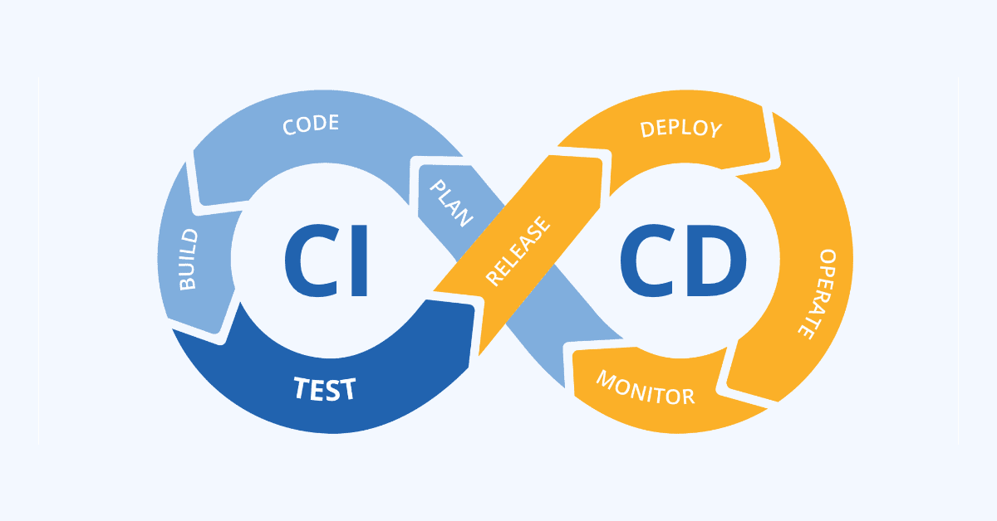
Slide 27

Slide 6
Application Design Pillars

Slide 7
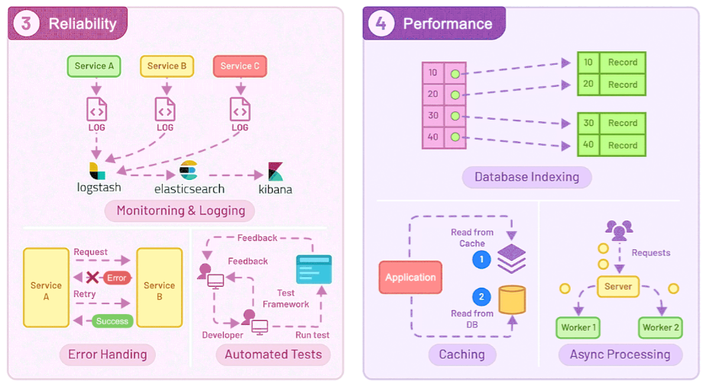
Slide 27

Slide 8
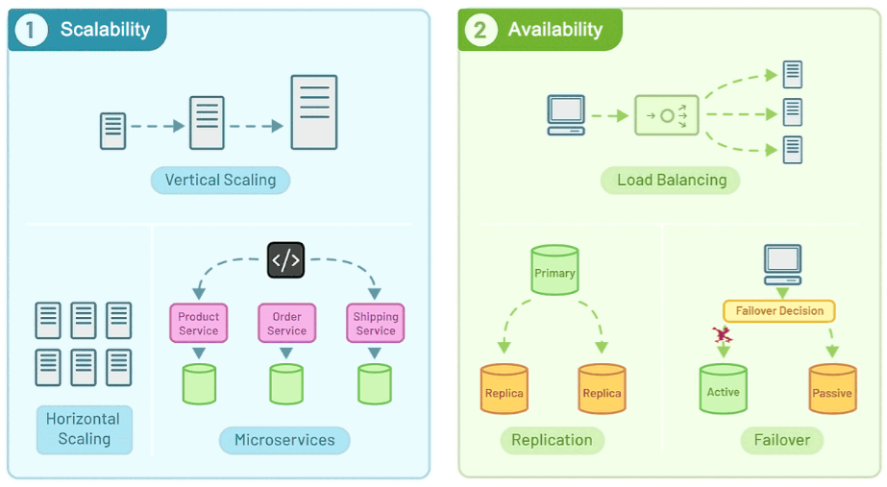
Slide 27

Slide 9
Common Components

Slide 10
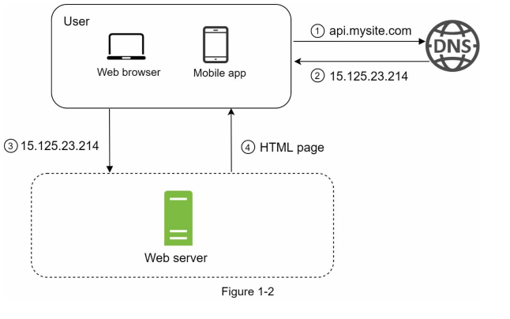
Slide 27

Slide 11
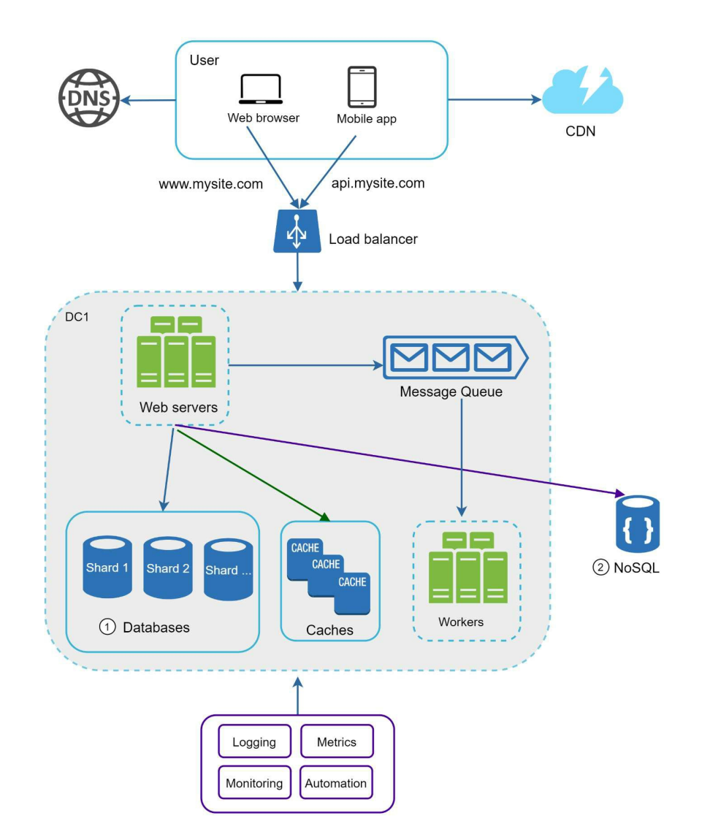

Slide 12
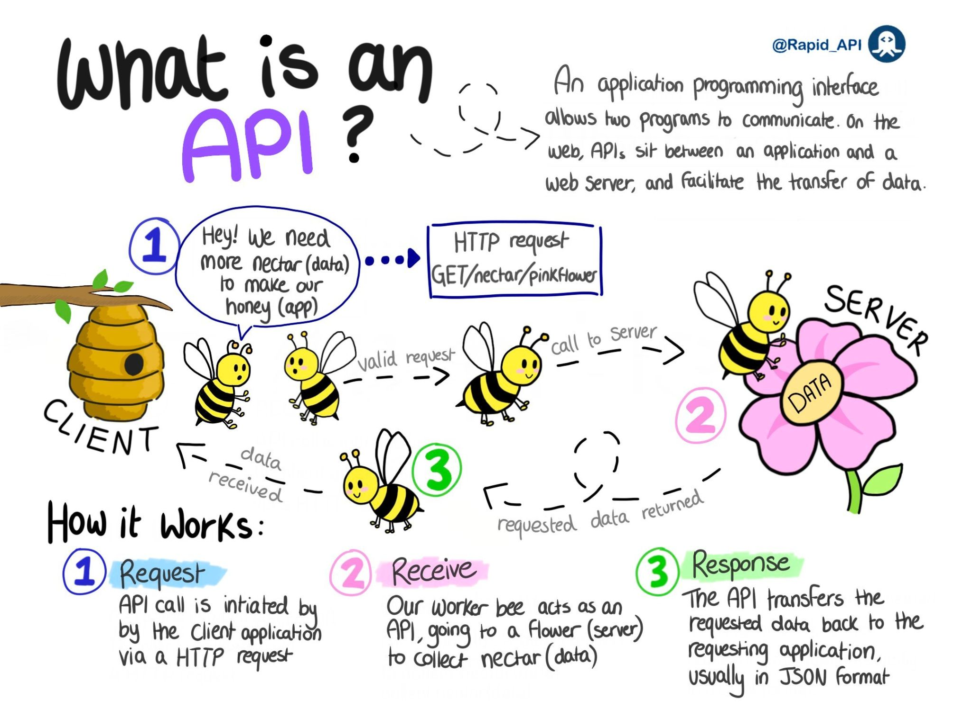
Slide 27

Slide 13
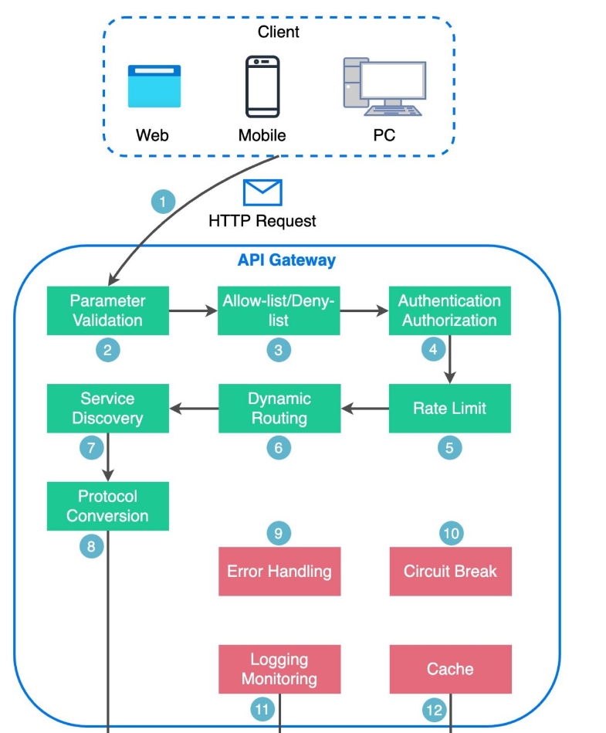
Slide 27

Slide 14
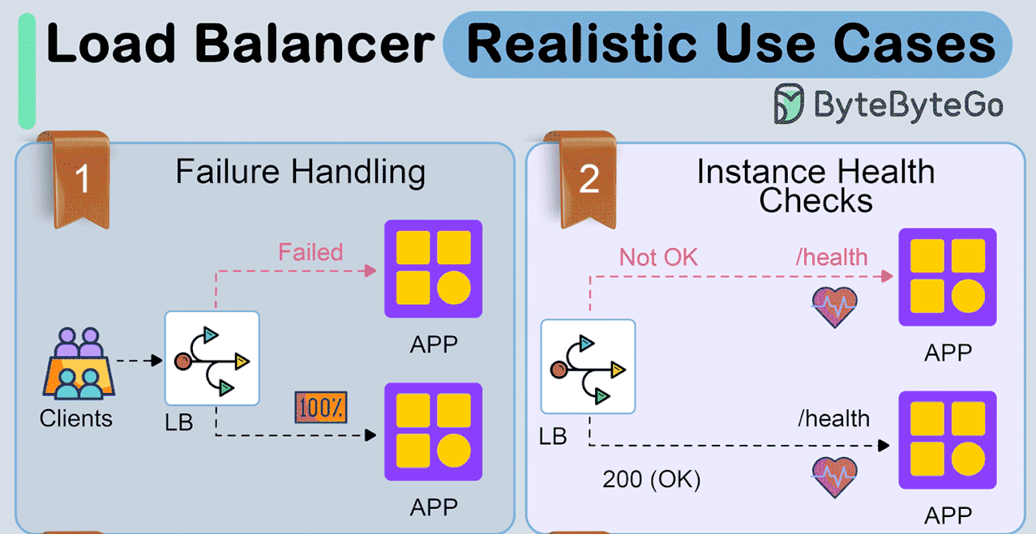
Slide 27

Slide 15
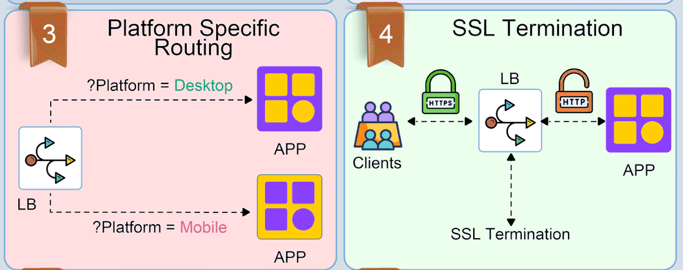
Slide 27

Slide 16
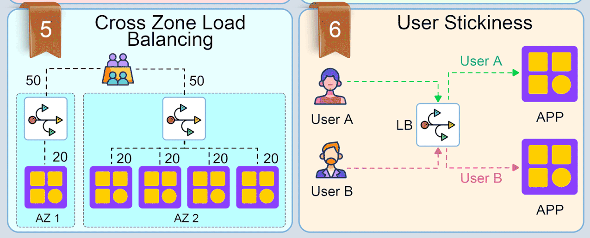
Slide 27

Slide 17
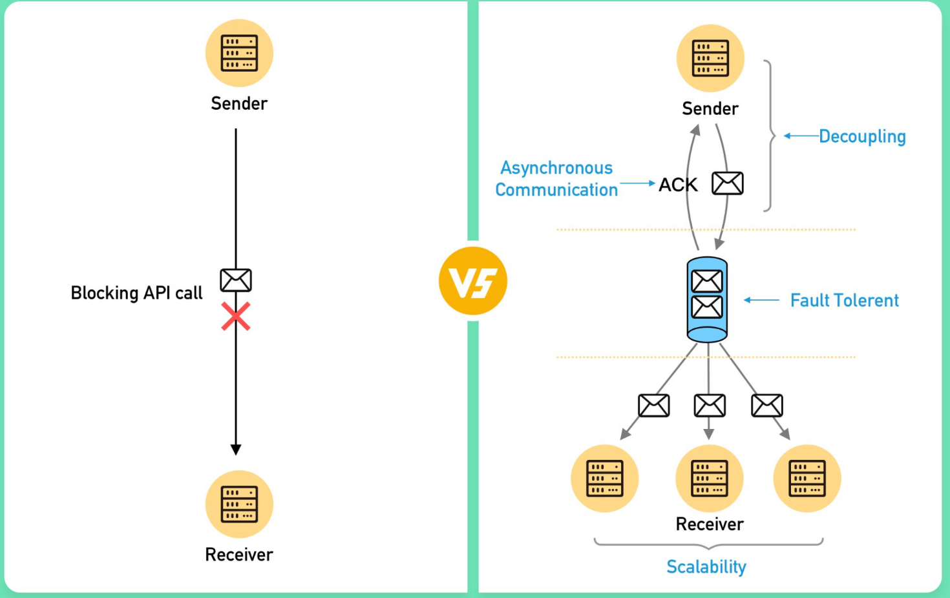
Slide 27

Slide 18
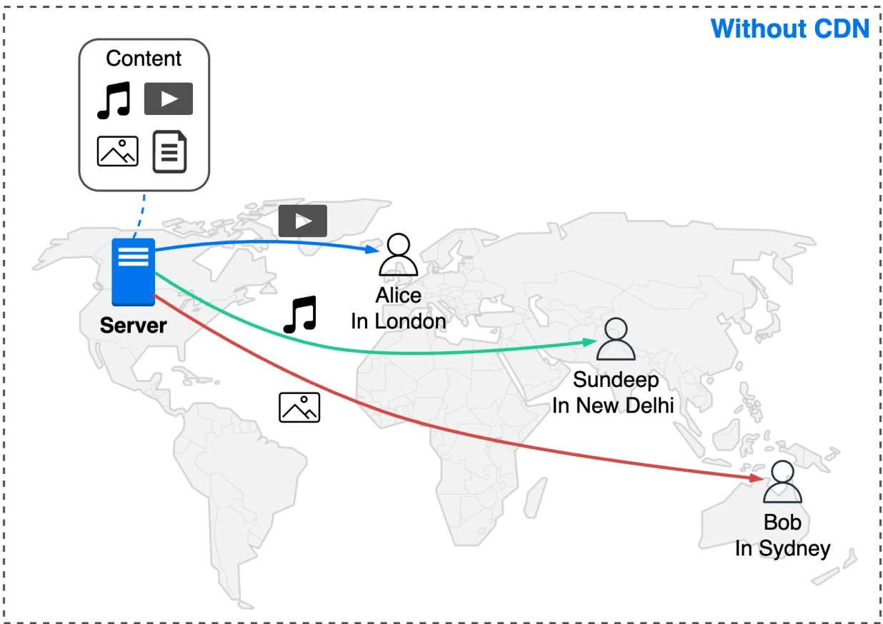
Slide 27

Slide 19
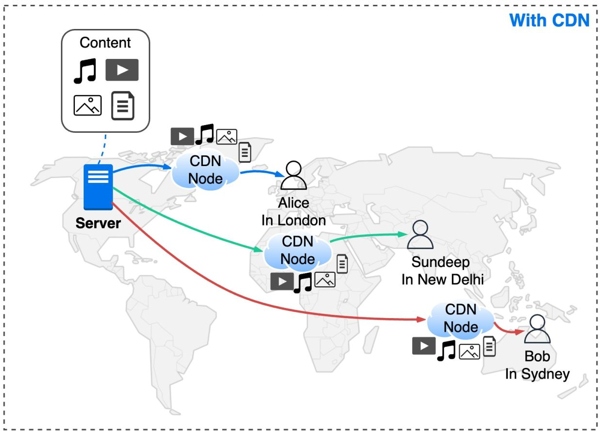
Slide 27

Slide 20
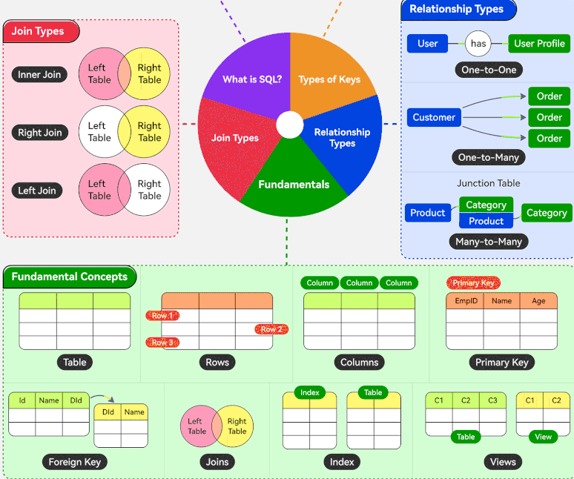
Slide 27

Slide 21
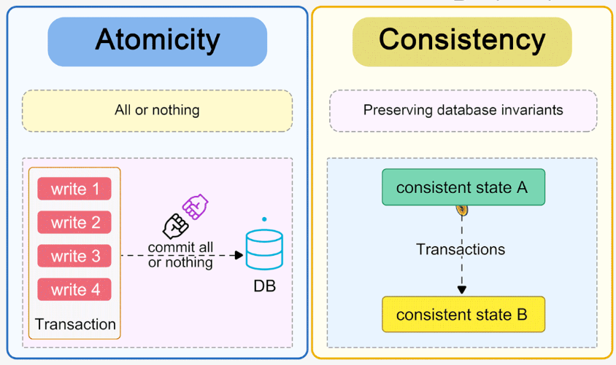
Slide 27

Slide 22
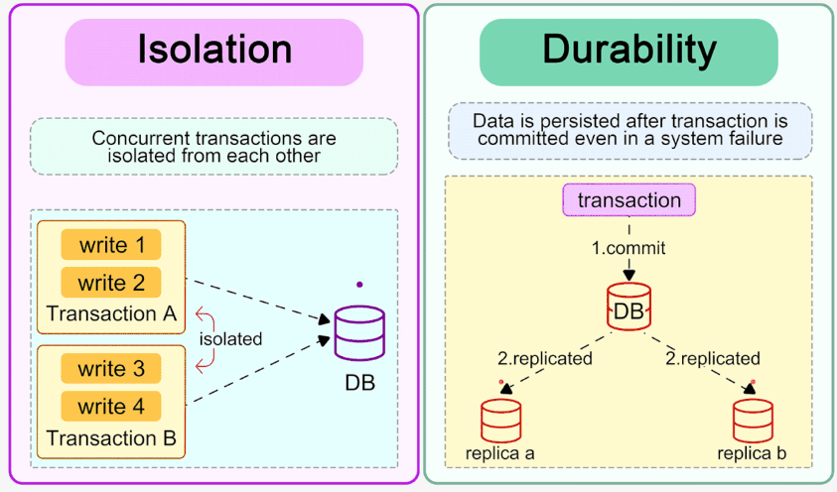
Slide 27

Slide 23
Patterns and Styles

Slide 24
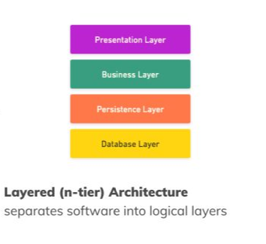
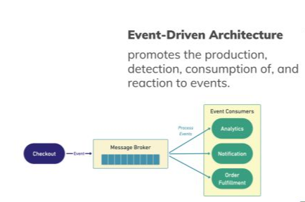
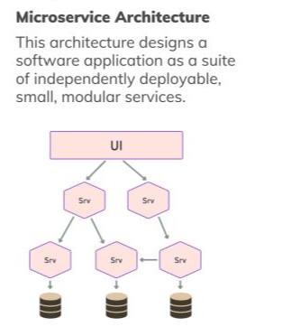
Slide 27

Slide 25
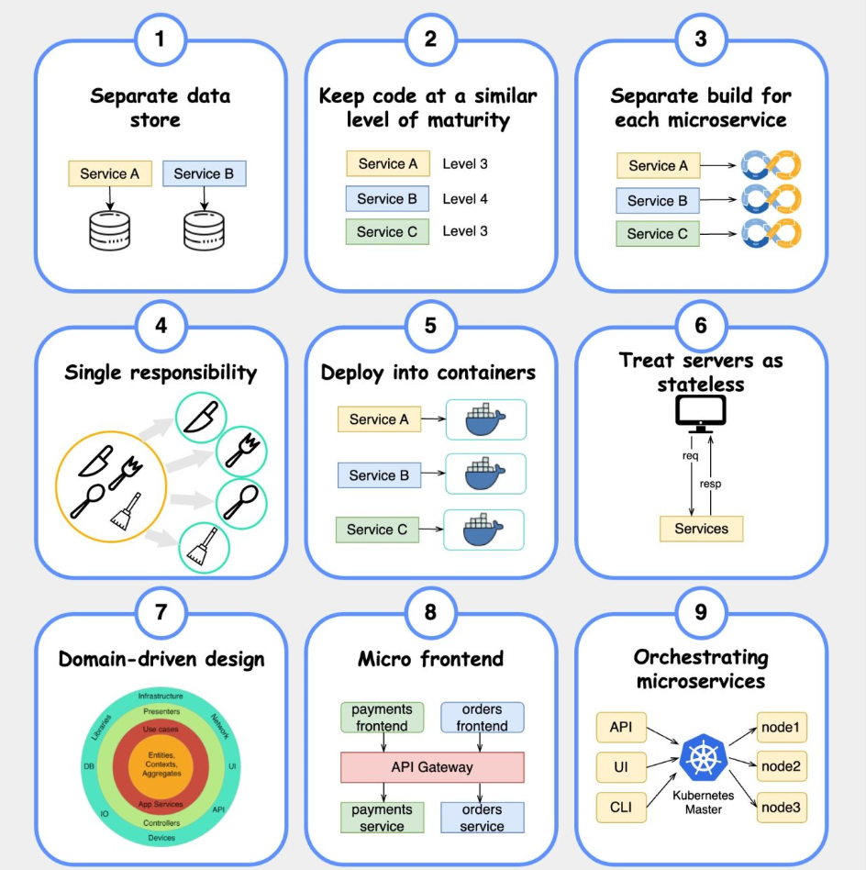
Slide 27

Slide 26
Thank you !

